Slide 1
Anime Recommendation System
- By Project Team ID 18
Akshay Dhabale
Axel Dzeukou
Mrinal Rai
Yogesh Yadav

Slide 2
Research Questions
Build an anime recommender system that provides personalized anime recommendation to its user based on explicit ratings
KNN item-item recommendation using cosine similarity and pearson coefficient distance
ALS + bias recommendation using latent factor
Study the models and draw comparisons between them
Evaluate the performance of each model using RMSE

Slide 3
Dataset
Source
https://www.kaggle.com/datasets/hernan4444/anime-recommendation-database-2020
Details
Input files - anime.csv and rating_complete.csv file.
Anime.csv file contains useful information such as anime id, name of the anime and genre etc.
Rating_complete.csv file contains useful information such as user id, anime id and rating by the users for animes.
Rating data includes
57M records
Distinct 31K users
Distinct 16K animes.
Ratings Data statistics
Ratings columns range (0,10)
Mean - 7.51
Standard Deviation - 1.69
Sparsity of utility matrix is ~ 98.90%
In our dataset around 10% of the animes are more famous and has more number of ratings.

Slide 4
Model Design
Alternating Least Squares (ALS)
Utilized spark.ml library implementation of ALS.
Used Latent factor based collaborative filtering.
Used explicit ratings from users on anime, on a rating scale from 1 to 10 and made extrapolations from data to predict user ratings.
Hyperparameter-tuning and cross-validation - to find best model parameters
ParamGridBuilder - to define tuning parameters
RegressionEvaluator - to RMSE calculation
CrossValidator - to compute average evaluation metric
Added bias to ALS to make predictions based on user-item interaction
K-Nearest Neighbour (KNN)
Spark.ml does not include library for K-Nearest Neighbour implementation like ALS.
Goal is to develop KNN completely in Pyspark
In KNN, focus is to implement item-item based collaborative filtering using cosine and pearson coefficient distance.
Notes:
2. Hyperparameter tuning and cross validation
ParamGridBuilder: We will first define the tuning parameter using param_grid function, please feel free experiment with parameters for the grid. I have only chosen 4 parameters for each grid. This will result in 16 models for training.
RegressionEvaluator: Then define the evaluator, select rmse as metricName in evaluator.
CrossValidator: Now feed both param_grid and evaluator into the crossvalidator including the ALS model. I have chosen number of folds as 5. Feel free to experiement with parameters.

Slide 5
Data Preparation
Ratings Data
Checked for count of Null, None, NaN for all columns
Checked for duplicate user_id-anime_id pairs
Random Train/Test split (0.8,0.2)
ALS
Read user id, anime id and ratings column into dataframe from ratings_complete.csv for model training
Calculated user-item interaction using the formula rating-(user mean + item mean - global average)
Computed the predicted rating with the formula user_item_interaction + user_mean + item_mean - global_average
KNN
Input data : Item-User Ratings Sparse rdd
Input to model : Intermediate rdd which store all Item-Item combination to calculate similarity distance
For Pearson coefficient distance measure, user rating deviations is calculated using user mean ratings and actual ratings for generating the intermediate rdd of item-item pairs.

Slide 6
Model Implementation
ALS
Obtained the best model (Model with the lowest RMSE) using Hyper-parameter tuning
Fit the model using random train/test split and evaluated predictions on test dataset
Added bias to ALS by calculating user-item interaction
Computed predicted ratings using test results
Used ALS build-in function to generate the top 5 animes for each user.
Converted the recommendations into interpretable format by joining rating_complete.csv with anime.csv
KNN Implementation
Model calculates cosine similarity, pearson coefficient similarity for each item-item combination
Model then calculates cosine and pearson coefficient distance using ratings and similarity measure for each item-item combination
Model recommends Top 5 nearest anime details for an input anime using similarity distance
Model recommends Top 5 anime details for an input user using similarity distance

Slide 7
Model Evaluation
Root Mean Square Error
In ALS implementation, RMSE of 1.17 without bias and RMSE of 1.16 with bias was achieved.
In KNN implementation, RMSE of 2.09 with cosine distance and RMSE of 2.27 with pearson coefficient distance was achieved
Comparison of Models
Performance : ALS pyspark model converge faster than KNN model.
Popularity : ALS helped in removal of popularity bias
Scalability : ALS did not face any issue with scalability unlike KNN
First Rater : KNN cannot recommend an item that has not been previously rated unlike ALS

Slide 8
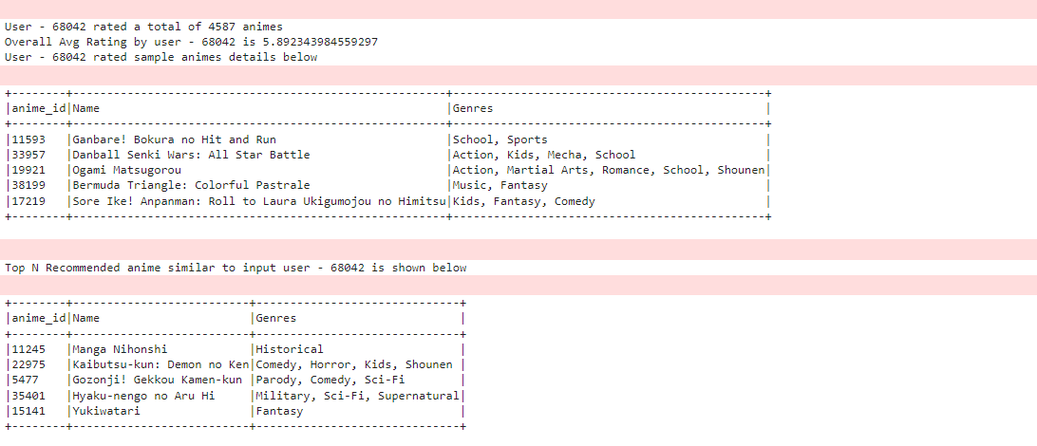
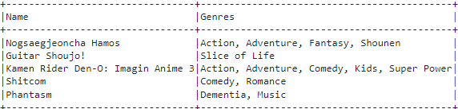
Model Recommendations
KNN - Cosine Similarity
ALS
Notes:
matrix factorisation unravels patterns that humans cannot, therefore you can find ratings for a few users are a bit off in comparison to others.

Slide 9
Discussion / Q&A

Slide 10
Thank You

